Slide 1

Presenter Instructions
RESOURCES
Contributors:
Sani Chabi Yo
Kamala Dasika
Ben Laplanche
Slack:
#sme-pcf-services
Drive:
Content/Services
Review in progress
Intended audience: IT Operation
Duration:
Storyline
Problems
Application developers experience long waits and manual processes in order to get access to the services they need, as infrastructure is provisioned, installed and configured - all delaying their ability to deliver the features that the business and customers depend upon.
Operators have to invest effort into understanding how to operate these services, become experts in their various components and Day 2 operations in order to ensure the services uptime availability and capacity is optimal.
Solutions
BOSH/Ops Manager to build managed service offerings that can be easily deployed, configured and made available to the developer community in a matter of hours rather than months. Including the full complement of Day 2 operations capabilities such as software upgrades and zero downtime deployments.
The powerful Services API to build services brokers that integrate external services and products into the Cloud Foundry platform and application developer workflow.
Send any feedback and deck customizations to syo@pivotal.io

Slide 2


PCF Services for Ops.
Name
Title
Contact info

Slide 3
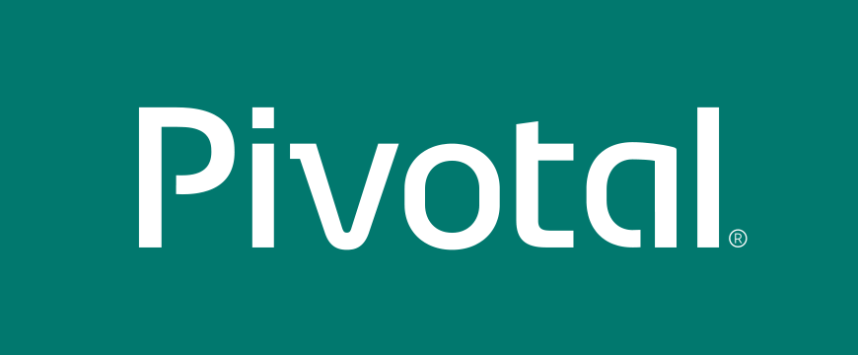
AGENDA
PCF Services
Overview
Day 2 Operations
Custom Services
Service Broker
Custom PCF Tile
User-Provided
Next steps

Slide 4
Review: Pivotal Cloud Foundry Architecture
Pivotal Network
PCF Apps Manager
Apps Manager: to manage applications, service broker dashboards, usage reporting
Cloud Foundry API
Service Broker Marketplace
Service Marketplace: expose services in Platform marketplace for sharing with the developer community
Pivotal CF Elastic Runtime
CI Services
Data Services
Mobile Services
Ops Manager: exposes services in the marketplace for sharing with the developer community
Others
PCF Operations Manager & BOSH
4
Notes:
First let quickly review PCF architecture
What is a Service:
Services are things that are consumed by applications running on the pivotal CF platform so these could be database services. They could be messaging services. They could be logging services.
Services integrate with the platform by providing a Service Broker API that cloud operators install in the platform
Allows resources to be easily provisioned on-demand and made available to applications

Slide 5
Why Pivotal Cloud Foundry Services
Elastic Runtime
MySQL for PCF
Redis
For PCF
RabbitMQ for PCF
Operated ‘as a Service’
Configured and integrated to enable push button deployment.
Full lifecycle management - software updates and patching
Bind to apps through an easy-to-use interface
Common view into access control and audit trails across a breadth of services
PCF Operations Manager
Elastic Runtime integrated into leading data services; all scaled and managed by PCF Ops Manager
Notes:
In many organizations, provisioning of data and messaging services for applications can take weeks, if not months because of the number of teams, administrators and exchange of credentials involved. We are striving to address this problem by providing a common model for services deployment via Pivotal Cloud Foundry that developers can easily find and their applications bind to – and scale those services as needed.
PCF Services allow administrators to provide pre-defined database and middleware services, and this gives developers the ability to rapidly deploy a software product from a menu of options without the typical slow and manual provisioning process. This is also done in a consistent and supportable way. PCF Services are managed and operated ‘as a Service,’ and this means they are automatically configured upon request. The provisioning process also incorporates full lifecycle management support, like software updates and patching.
This automation removes the overhead from developers, who are often saddled with service configuration responsibility. It makes administrators’ lives easier and addresses security risks by standardizing how services are configured and used.
Transition: An important thing to point out is the fact that MySQL and the others Pivotal Services are enterprise ready, what do we mean by that?

Slide 6
And much more…
HIGHLY AVAILABLE
AZ SUPPORT
ROLLING DEPLOYMENT
AUTOMATED VERSION UPGRADES
As an Application Developer, I expect my services to be resilient to failure, so that my application maintains uptime.
As an Operator, I want to deploy services across different IaaS Availability Zones, so that an AZ failure does not take the whole service offline
As an Application Developer, I do not expect to experience a prolonged outage during a deployment of the service, so that I can maintain uptime..
I expect all components of a service to be upgraded to the latest versions automatically through OpsManager, so that I do not have to perform any manual steps.
OPERATIONAL MONITORING & LOGGING
As an Operator, I want visibility into the operational health, performance and logs of my services, so that i can monitor their uptime and diagnose any issues
BACKUP & RESTORE
As an Operator, I expect all services to be able to be backed up and restored, so that I can provide disaster recovery facilities
SCALE
As an Operator, I expect my services to operate at scale, so that i can handle large workloads.
MORE..
Notes:
1. Each service should offer some form of redundancy in the event of a component failure
2. Support for a service to be deployed across multiple availability zones

Slide 7
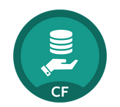
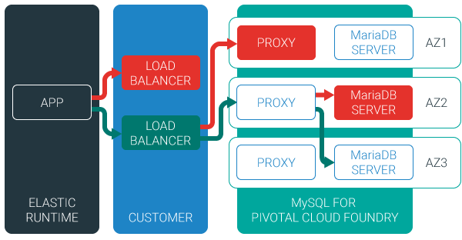
Example: MySQL Service
Relational Database as a service
Minimized effort to create, configure, and manage a MySQL cluster
Multi-node cluster
Data replication across nodes
Failover functionality ensures app traffic only routed to healthy nodes
Notes:
Deployed with a multi-node cluster; Balanced across Availability zones
Highly Available
Data replication
Failover functionality
Customizable plans
Secure - Different credentials to each application, operators can revoke access selectively!

Slide 8
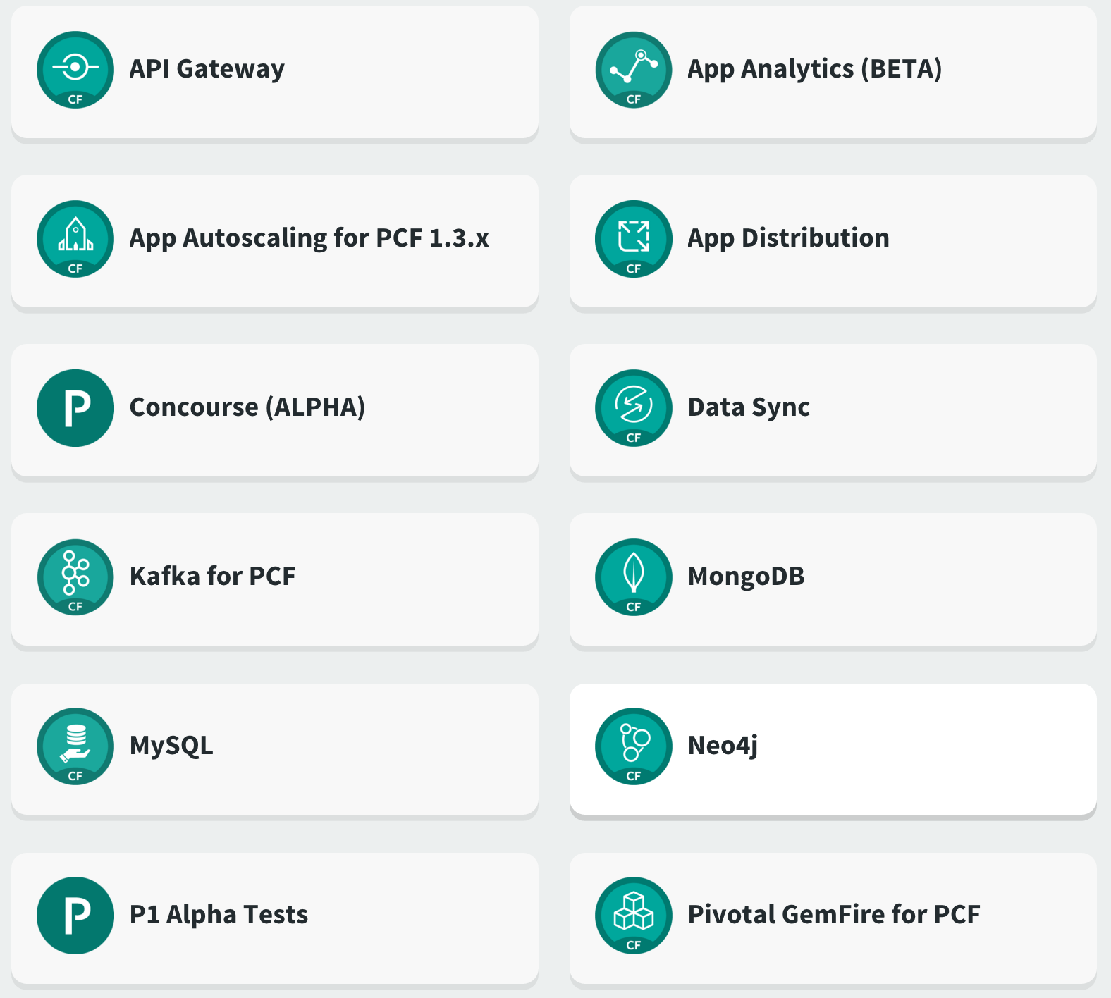
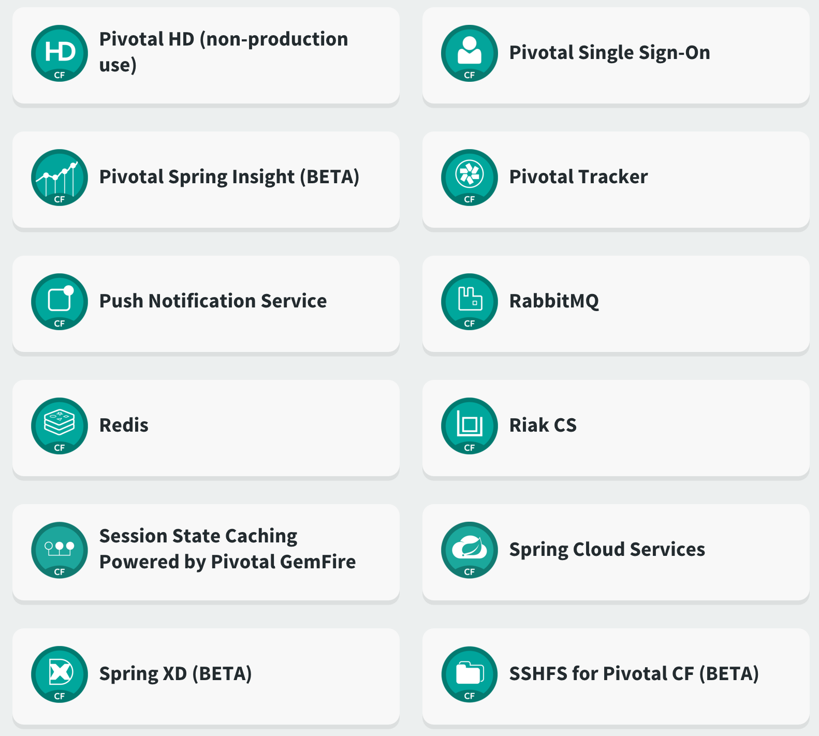
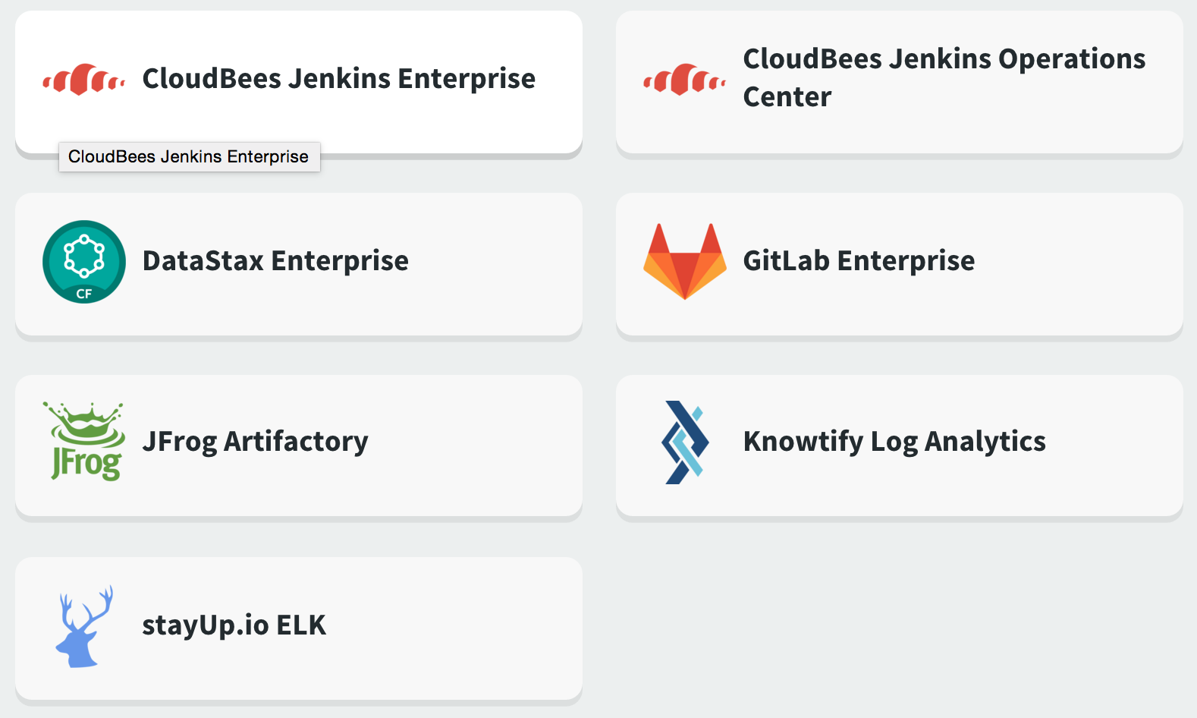
PIVOTAL NETWORK
https://network.pivotal.io
8
Notes:
1. Cloud Bees Jenkins Enterprise for PCF. Many of you listening will be very familiar with Jenkins, it is probably the leading continuous integration, continuous deployment tool that’s out there. Jenkins by Cloud Bees is integrated entirely into PCF by giving you enhanced application developer workflow. What this means is it’s tied in very closely to things like UAA for single sign on functionality, it can segregate builds by users in space, it deals with the isolation for you. The Cloud Bees Jenkins enterprise tile is a really quick and easy way to get your own Jenkins server or servers set up in your environment and used for your development projects.
If your scalings are larger, you’ve got lots of development servers, lots of Jenkins servers in your environment, then another tile comes into play and this is the Cloud Bees Jenkins Operation Center. It let’s you manage multiple Jenkins Enterprise masters. Think of it as a master of masters to some extent. If you’re deploying a large number of Jenkins servers in your environment then this is the tool that you want to manage it for you. With Jenkins from Cloud Bees we have the ability to do a CI/CD using a very well known, very well supported tool, that works super well obviously for Java, but also for lot’s of other languages including Ruby, Node.js, etc.
2. . Another interesting tile is the ELK for PCF. This is produced by StayUp.io. ELK is elasticsearch, logstash and Kibana for those of you playing along at home. Essentially it provides a really nifty visualization and activity engine to see what your applications are doing within PCF. Essentially what it let’s you do is get deeper insight into what’s happening with your application, take action appropriately, and this can help you do things like rolling out new versions, making sure that the new versions you roll out are actually useful, are the performing better than the old version, etc.
3. Another one that’s really important for you workflow is one called GitLab. GitLab provides Git which is probably the best known source code repository going around these days, probably one of the most popular ones in more modern development teams. GitLab prides itself on providing a very robust enterprise grade get capability that includes things like multiple active servers and other highly available set ups so you can have really scalable implementation. You can run more users on a single server than most other source code repository types. It also has an even more granular security model as well for who gets access to what in the environment. If you’re doing any project you’re going to need some sort of control, the benefit of having this tile means you can very simply, easily, and quickly deploy your source control in your environment and use it in a common way.
Transition:

Slide 9
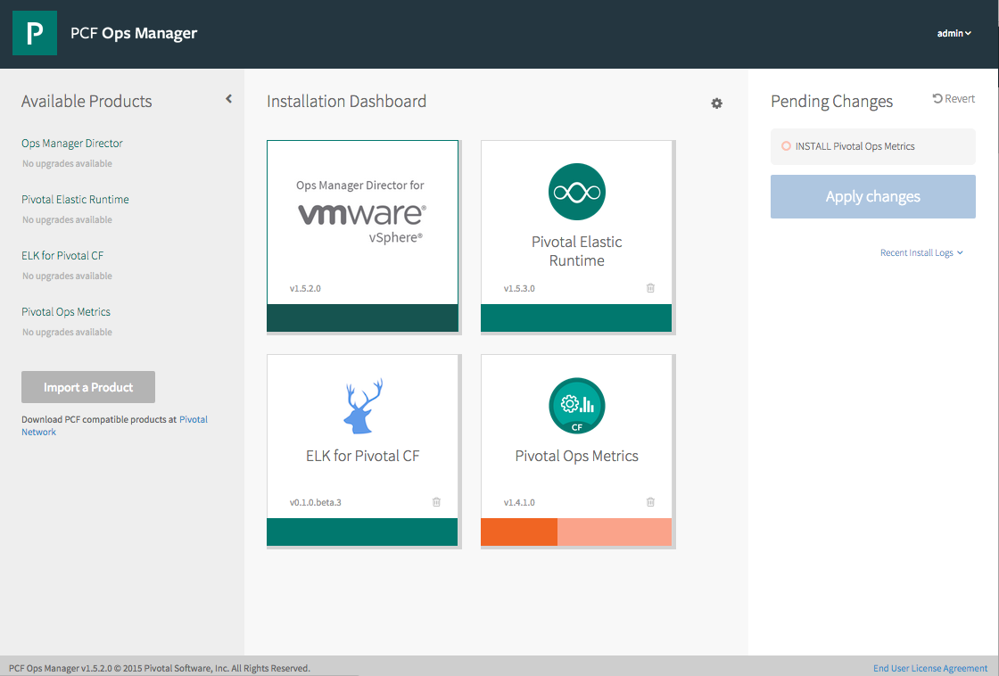
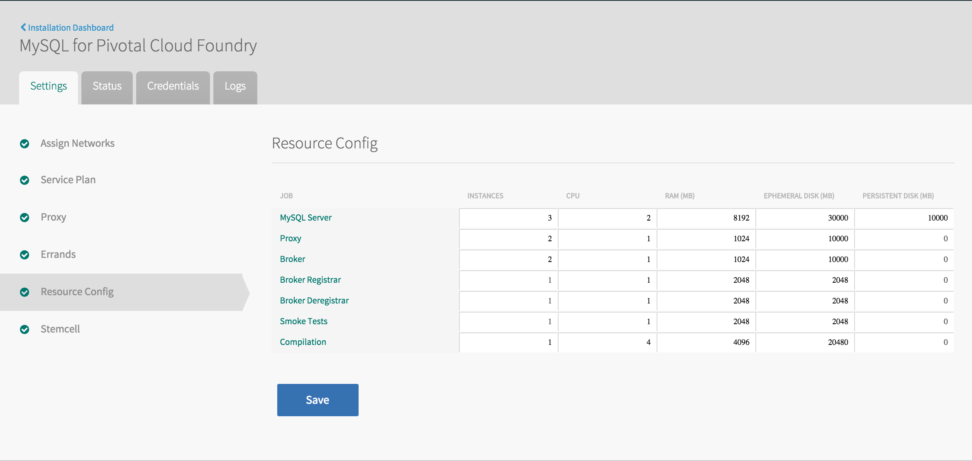
Installation & Configuration

Slide 10
Scale

Slide 11
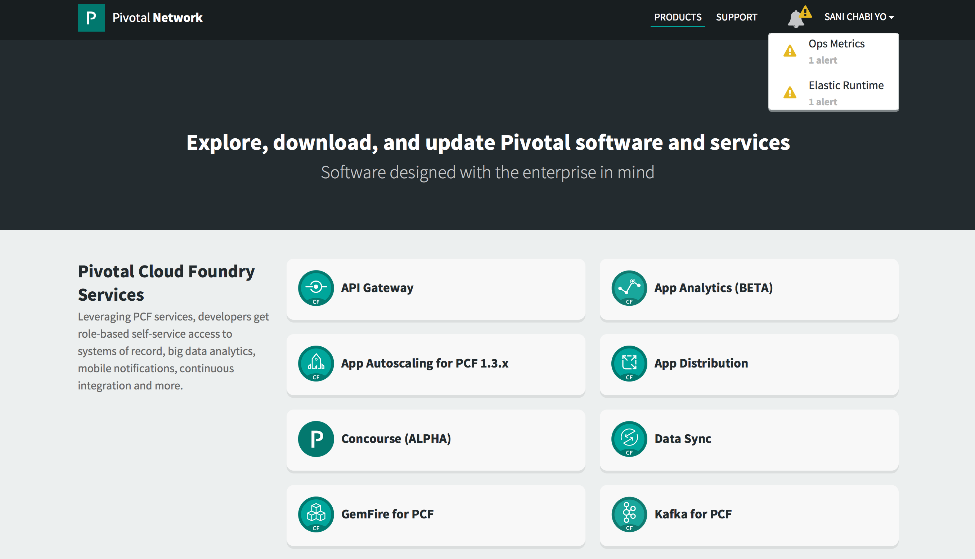

Slide 12
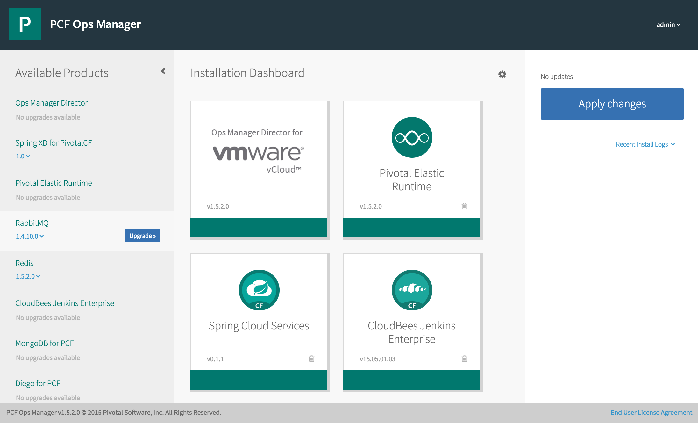
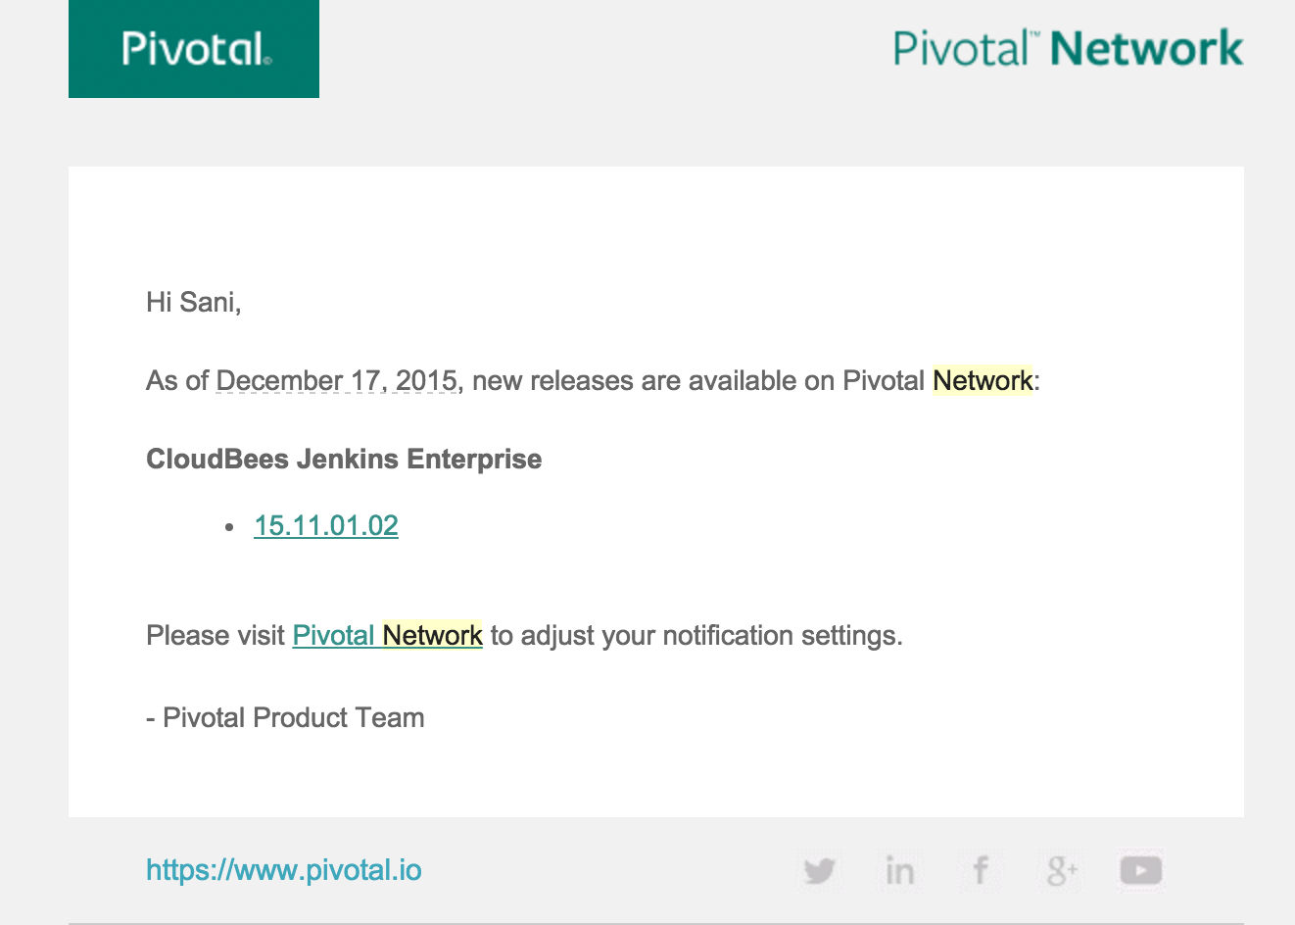
Upgrade
Notes:
Patching and upgrading installed PCF products is very similar to installing new products:
Verify that the current version is supported to be upgraded according to the release notes, as well as any required dependencies.
Import the new version of the product in the Ops Manager UI.
Click the Upgrade button for your product.
Optionally, change any configuration settings needed for your product (i.e. enable errands that were disabled previously).
Click the Apply Changes button.
Transition: We have explored some of the cool Pivotal products available as Product Tiles within Pivotal Cloud Foundry® (PCF). This sparked some questions about how you can create your own. Let take a look of that.

Slide 13
CUSTOM SERVICES IN PCF
Notes:
One of the great things about Pivotal Cloud Foundry® (PCF) is how easy it is for 3rd parties to add in new capabilities. In particular, by using the Operations Manager to easily import, install and expose new services to users of the platform.
What: What these services are, are tiles that you can easily import into the Ops Manager and implement new services within PCF that are provided by our third party partners. These are other products that are developed by other people, but can be deployed in and managed by Cloud Foundry under the control of the Ops Manager.
Why: Why would you want to do this? This means that you can easily implement these new services in your environment, you can run them on a variety of platforms depending on the particular service itself, and you can still get commercial support from those providers. They’re providing a different way to deliver their product to you and to your developers and operations teams, an easy way to consume from the PCF console.

Slide 14
3 options
Service Broker
A simple and consistent way to access services that may be running on top of Cloud Foundry, controlled by Cloud Foundry or running totally independently of Cloud Foundry.
5 RESTful APIs
Expose services in the marketplace
Custom PCF Tile
Service instance managed inside Pivotal Cloud Foundry.
Most of the time uses a Service Broker.
Enterprise grade services.
Same experience as PCF Products
User-Provided
Service instance which have been provisioned outside of Cloud. Foundry.
Behave like other service instances once created.
Eliminate the need to hard code service instance endpoints.
Notes:
There are 3 way to get your own services in PCF
1. Service broker - A service broker is a set of 5 REST endpoints that implement the lifecycle of developers interacting with a service. A service broker can run on PCF, or anywhere else, and it’s URL is registered with PCF. Most customers create service brokers for existing enterprise services that are managed externally but are used by many applications, like an Oracle database or a message broker. Most PCF products also create a service broker as part of the installation. Note that service brokers do not act as a proxy between an application and the service. All application and service communication is direct via the native protocol (JDBC, JMS, etc.).
2. Note that most PCF products ultimately expose themselves as services in Elastic Runtime, but this is not always the case (ex. Ops Metrics).
3.

Slide 15

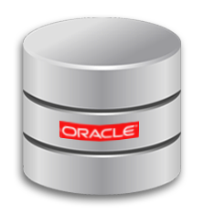
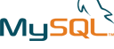

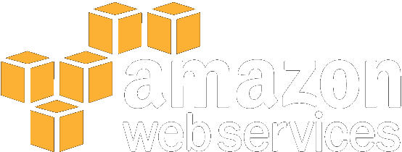
Service broker
Use-cases
Integrating with externally hosted SaaS products.
Integrating with on-premise but external to PCF (i.e. Legacy database)
Official Service Brokers
App Direct
External PostGres
External Oracle
External MS-SQL
External RDS, SQS
No on-premise deployable solution.
Comprehensible/Reliable API
Complex to automate with BOSH
When
Service Broker
Write a service broker that is deployed to PCF (as a VM or the runtime)
Integrate with the external service
Service API
Seamless Experience for developers
Treated as a product (maintenance, support, etc.)
Why
Full instructions can be found here http://docs.pivotal.io/pivotalcf/services/overview.html
Notes:
How does this approach work?
Write a service broker that is deployed to PCF (either as a VM or the runtime)
Integrates with the external service
What services is this approach suitable for?
Integrating with externally hosted SaaS products (such as AWS)
Integrating with on-premise but external to PCF solutions (such as a legacy database)
Decision criteria to use this approach?
There is no on-premise deployable solution!
This is a simpler first implementation
The service has a comprehensive and reliable API
The service is operationally immature or complex to automate with BOSH
Why use this approach?
Leverages the power of the Services API
Integrates the external services into PCF, giving a seamless experience for application developers
It’s treated as a Product
Which ensures quality, maintenance, support.
It’s a real thing

Slide 16
Service Broker API
/v2/catalog [GET]
/v2/service_instances/:id [PUT]
/v2/service_instances/:instance_id/service_bindings/:id [PUT]
/v2/service_instances/:instance_id/service_bindings/:id [DELETE]
/v2/service_instances/:id [DELETE]
Notes:
The 5 REST endpoints that are exposed are:
Catalog - The catalog method is intended to get information about the service, such as a description of the service and different plans available. The catalog method is what gets displayed in the Elastic Runtime marketplace.
Create - The create method should create resources in the service. Those resources may be a new database or schema in a database, a new queue in a message broker, or a folder structure in a filesystem service. The create method will typically create new credentials for the service instance as well.
Bind - The bind method is invoked when an application binds to a service, and is responsible for returning connection information such as a URL or credentials to PCF. PCF then injects that information into the application via an environment variable called VCAP_SERVICES. This is similar to binding to a user-provided service. Best practice: Each binding is represented by its own credentials
Unbind - Unbinding tells the service broker to clean up any resources created during binding. Typically it will disallow access to the service.
Delete - The delete method should clean up any resources created by the create method, such as deleting a database or schema that was created.

Slide 17
Service broker Deployment & Registration
1. Deployment models
2. Registration
Entire service (service backend + broker) packaged and deployed by BOSH alongside Cloud Foundry, rest of the service deployed and maintained by other means
Broker (and optionally service) pushed as an application to Cloud Foundry user space Foundry
Entire service, including broker, deployed and maintained outside of Cloud Foundry by other means
Make the service broker known to the Cloud Controller
cf create service-broker <broker name> <username> <password> <broker base URI>
Broker should ONLY allow access to those requestors it shared its credential with (Basic Auth)
Make ‘plans’ accessible to users in a specific org/space
cf enable-service-access SERVICE [-p PLAN] [-o ORG]
Admin creds/role is required
Full instructions can be found here http://docs.pivotal.io/pivotalcf/services/managing-service-brokers.html
Notes:
Because Cloud Foundry only requires that a service implements the broker API in order to be available to Cloud Foundry end users, many deployment models are possible. The following are examples of valid deployment models:
Registration

Slide 18
CUSTOM PCF TILE
Notes:
What: What these services are, are tiles that you can easily import into the Ops Manager and implement new services within PCF that are provided by our third party partners. These are other products that are developed by other people, but can be deployed in and managed by Cloud Foundry under the control of the Ops Manager.
Why: Why would you want to do this? This means that you can easily implement these new services in your environment, you can run them on a variety of platforms depending on the particular service itself, and you can still get commercial support from those providers. They’re providing a different way to deliver their product to you and to your developers and operations teams, an easy way to consume from the PCF console.

Slide 19
Custom PCF Tile
Stateful services (Databases)
Heterogeneous Services
Bigger scaling
Defined lifecycle
Use-cases
Mature service.
Sufficient demand to warrant the investment.
Service available to be installed on premise
Custom
PCF Tile
When
Tile Release cycle
2. Closed Beta
3. Public Beta
1. Alpha
4. Finale
Service is wrapped into a BOSH release and tile (i.e. .pivotal).
Product built to implements the enterprise Ready Criteria (if Data Service)
Power of BOSH Ops Manager
Implement Enterprise Ready criteria (Data Service.)
Why
Full instructions can be found here http://docs.pivotal.io/partners/
Notes:
Well what do I do if I want to create my own ones? Maybe I’m selling a product into the market and I’d like it to be capable of running within PCF or I’m maybe creating an internal product that I want my developer community to access, etc. How do I go about that?
How does this approach work?
Service is wrapped into a BOSH release and tile
Product is built to implement the Enterprise Ready Criteria if its a Data Service
What services is this approach suitable for?
Stateful services - such as databases
Services that have a lot of components, such as databases, queues, file storage
Services that need scale bigger than the runtime can provide
Services that have a more defined lifecycle around upgrades, configuration
Decision criteria to use this approach?
Sufficient customer demand for a BOSH managed solution to warrant the investment
Service is operationally mature, declarative
Partner company identified to provide tier 2 & 3 support
Service is already available to be installed on-premise by customers in some form (e.g. source)
Why use this approach?
Power of BOSH & OpsManager for managed services delivers compelling value and customer benefit
Tile Release cycle
You’re doing a lot of changes, you’re refactoring code, you may not have a feature complete situation. This is really the stage in which your internal developers are consuming the tile that you’re building and just working it and making sure it’s getting to sort of a MVP stag.
Then we have the next phase which is the closed beta phase. This is where we provide this to a limited pool of users, for testing so that they would be able to use it to test it out to see what’s good, what’s bad, what things need to change, etc. During the closed beta things may break, there’s no guarantee that data loss won’t take place for the service, there may be bugs, you might not be able to upgrade your tile, you might have to delete and install, etc. To be a closed beta it has to run on at least one of the IOS’s, so it could be AWS, vSphere, or OpenStack. It’s got to target the stem cell version of the latest available Pivotal ops manager and also the release notes aren’t very clear about the fact that this is a limited beta and closed beta, I should say. Should not be used for anything other than experimentation.
Once you’ve done that and gone through that process, you can then go through what’s called a public beta process. This exposes you to a much broader pool of users and let’s you get far more feedback and as we know with product development, feedback is important. In the public beta phase, you have much more confidence that further development isn’t going to break the product and you’re not going to lose any data, but you’re not making any guarantees but you’re still being a lot more quality focused there. The tile can be upgraded and this is not the final release but it’s getting reasonably close to it. Upgrades of the tile do not result in any data loss or configuration loss. The other interesting thing that we’re adding at this stage is that you, as the provider, can respond to discovery of a security flaw, a CVE or common vulnerability and exposure within a reasonable time frame. These security flaws could be vulnerabilities in your stem cell or within the components of your tile so you have to maintain that. Certainly we attempt at Pivotal to respond to all critical CVE’s within 48 hours.
The final release is general availability. This is when it’s production ready, this is when you can charge money for this product if you want to and you can provide support guarantees to your customers. You have all the features that you want in the product. What this means is that the product, as well as everything else that we spoke about, can scale vertically, so it can upgrade itself to run on larger instances. You can also, if it’s appropriate, scout horizontally for higher availability, so you can have more nodes and more performance. If appropriate the product supports zero down time deployment and also that the product installation does not require an internet connection as well. What this means is that you can run the whole application end to end as a product.

Slide 20
User-Provided Service
User-provided - A user-provided service is simply a list of connection parameters that are stored in the platform and provided to an application when it binds to the service.
User-provided services are useful for quickly getting parameters to an application, without having to create a service broker and registering with it the platform. They are also helpful for services that will probably only be used once or twice.
Applications connect to the same instance.
User-provided services are created using the CF CLI’s create-user-provided-service command, which takes an arbitrary set of key/value pairs as an argument.
> cf create-user-provided-service my-old-db –p ‘{“user”:”admin”,”password”:”pwd”}’
Full instructions can be found here https://docs.pivotal.io/pivotalcf/devguide/services/user-provided.html

Slide 21
Q&A

Slide 22

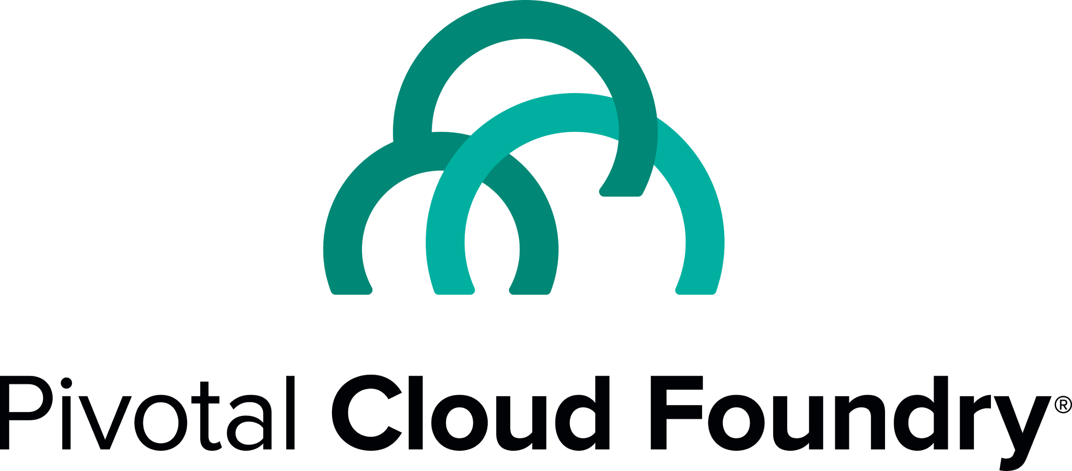
Next steps
Pivotal Cloud Foundry Workshop
BOSH 101
Service Brokers
Custom Ops tile

Slide 23
REFERENCES
Service Brokers
Service Broker API
Managing Service Brokers
Partners Services.
PCF Partner guide
Partner Services for PCF (scroll to the middle of the page!)
Custom PCF tiles
Creating a Product Tile
Sample Product Tile
Notes:
Let see how it works ender the hook

Slide 25
Slide Appendix

Slide 26

Redis for Pivotal Cloud Foundry
Advanced Key-Value Store and Cache as a Service
Pre-provision a pool of Redis VMs
Supports persistence to disk
Consolidated logging and monitoring
VM health monitoring, and recovery
User Application
Binding
Instance (Redis process)
VM
VM
VM
VM
Pre-provisioned VMs in the ‘pool’
Ready to be created as instances and bound with apps
Notes:
Developers can quickly develop features for their applications such as:
live, in-memory caching for very fast reads
real-time computation on data structures
ranked lists and leaderboards
publishing and subscribing
queuing

Slide 27

RabbitMQ for Pivotal Cloud Foundry
Apps safely send and receive messages at scale
Messaging broker for communication between servers, applications and devices
Highly available queues, flexible routing, support for multiple protocols and client libraries
Wide range of client libraries, in all languages
Push button deployment and upgrades of a RabbitMQ Cluster
HA Proxy
RabbitMQ Node
AZ1
RabbitMQ Node
RabbitMQ for PCF
App
Elastic Runtime
Scale out service as required

Slide 28
Service Broker Provisioning examples
The result of provisioning varies by service type, although there are a few common actions that work for many services. For a MySQL service, provisioning could result in:
An empty dedicated mysqld process running on its own VM.
An empty dedicated mysqld process running in a lightweight container on a shared VM.
An empty dedicated mysqld process running on a shared VM.
An empty dedicated database, on an existing shared running mysqld.
A database with business schema already there.
A copy of a full database, for example a QA database that is a copy of the production database.
For non-data services, provisioning could just mean getting an account on an existing system.

Slide 29
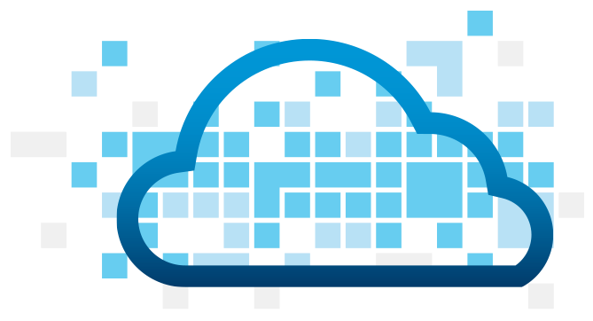
Creating and Binding Service
DB
Service
credentials
CLI
create service (HTTP)
Cloud Controller
create service (HTTP)
Service
Broker
reserve resources
Data
Service
Router
bind service (HTTP)
bind service (HTTP)
obtain connection data
Runtime
29
Notes:
An application runs in a DEA, which is a droplet execution agent. The Cloud Controller orchestrates the routing and lifecycle of all DEAs in the pool. Routers manage application traffic. Health Manager reports mismatched application states to the CC. A service gateway provides an interface for services (native or external). A messaging bus manages all system communication. Apps are accessed directly through the router while web and CLI clients (e.g., vmc, STS) access Cloud Controller via RESTful services.

Slide 30
Multiple PCF instances support
Notes:
http://docs.pivotal.io/pivotalcf/services/supporting-multiple-cf-instances.html
There are two strategies that can be used to discover which Cloud Foundry instance is making a given request.

